Slide 1
Dsa 210 term project
Emre Yontucu 32463

Slide 2
Purpose of the project
The purpose of this project is to analyze the personal data from Ticket Restaurant Card. By examining this data I aim to gain depper insights of by spending habits. So that this project mainly focuses on:
•Observing my eating behaviours.
•How my spending habits change between summer and school period.
•Identifying the food categories I spend most on.
•Tracking how quickly my balance depletes after each top-up.

Slide 3
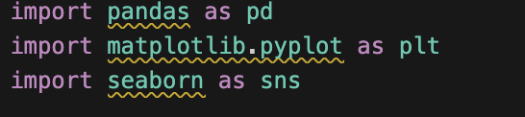
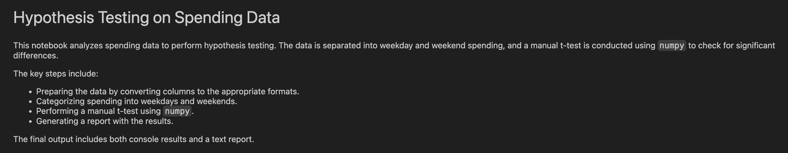
TOOLS
The following tools will be used in this project:
Python:
• Pandas: For data structuring.
• Matplotlib and Seaborn: For visualization.
• Numpy: For mathematical computations.
•Jupyter Notebook: For coding and analysis.
•Excel: For handling the raw data.

Slide 4
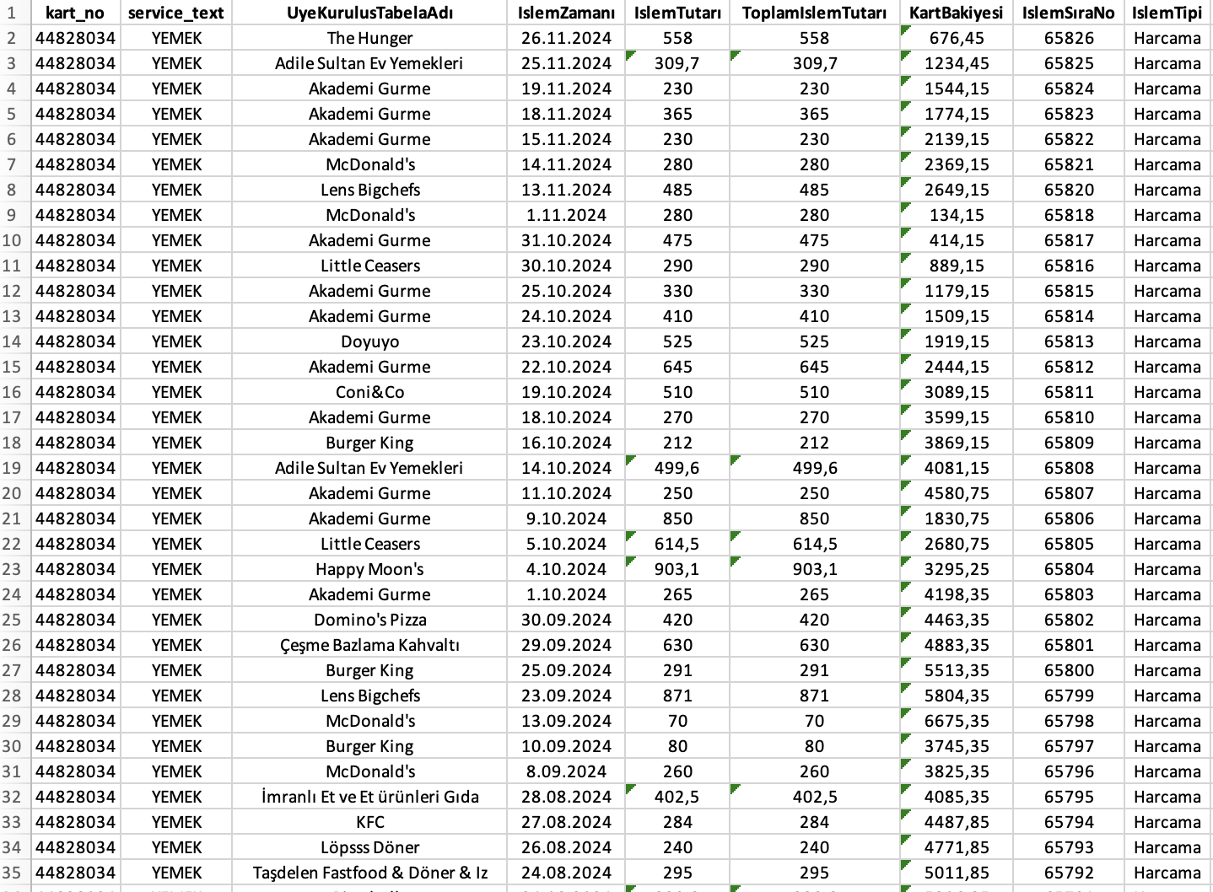
The data was retrieved from Ticket Restaurant application and exported in Excel format. This Excel table shows the:
Name of the restaurant that the transaction took place.
Date that where the transaction took place.
The amount of spending during the transaction.
Balance left after the transaction.

Slide 5
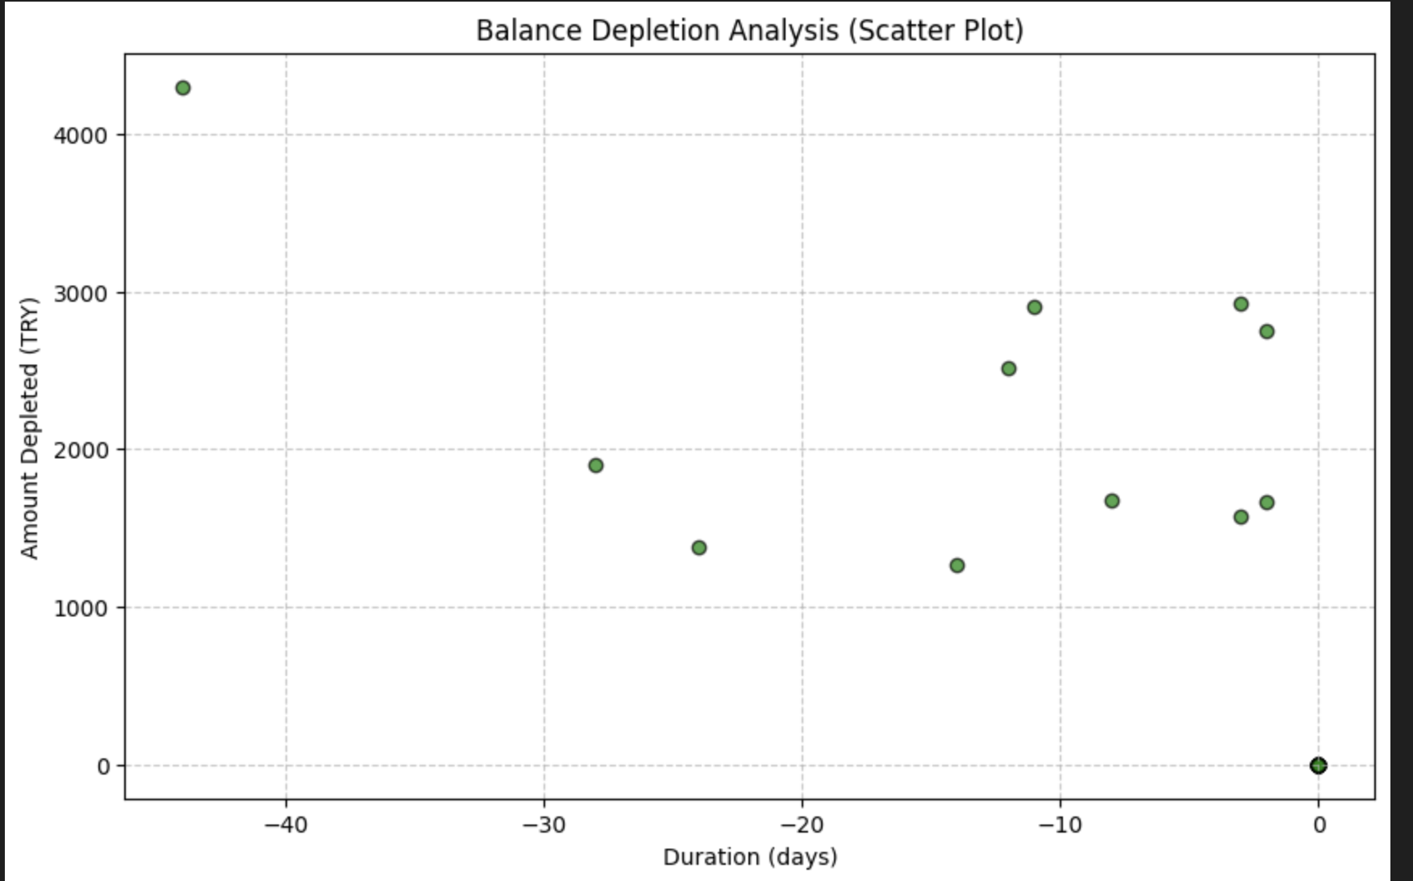
Balance deplatıon analysıs
This scatter plot, titled "Balance Depletion Analysis", depicts the relationship between the duration (in days) on the x-axis and the amount depleted (in TRY) on the y-axis
In the first 10-20 days, higher spending occurred, and the balance was depleted more rapidly during this period.

Slide 6
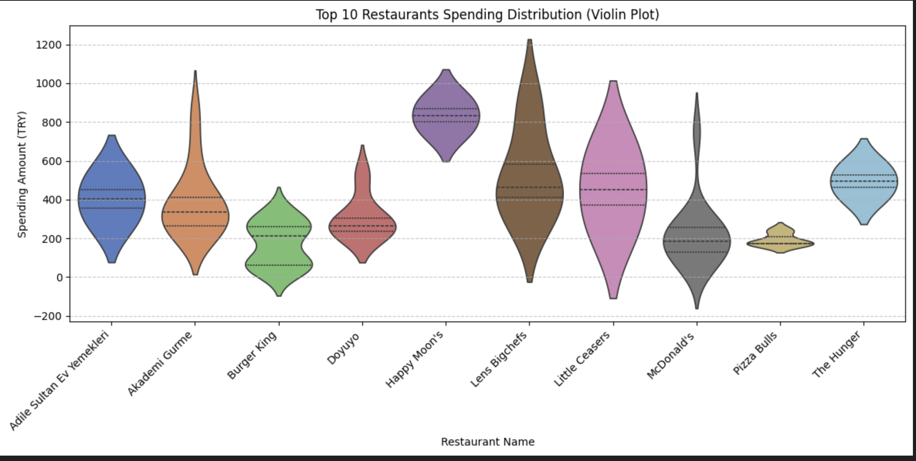
Hıghest spendıngs
This plot shows the spending amounts for the top 10 restaurants in TRY. Akademi Gurme and Little Caesars have a big range of spending, with some high amounts. Pizza Bulls has the smallest range, meaning people spend similar amounts there. McDonald’s has a balanced shape, while Lens Bigchefs has more high spending. Spending is very different between the restaurants

Slide 7
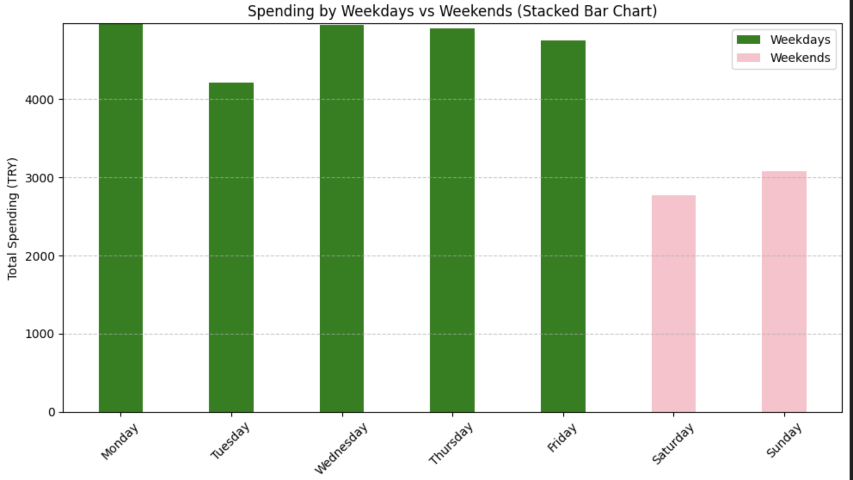
WEEKDAYS VS WEEKEND
This bar chart compares spending on weekdays and weekends in TRY. Weekday spending (green bars) is consistently higher than weekend spending (pink bars). The highest spending occurs from Monday to Friday, while Saturday and Sunday show lower total amounts. This suggests that spending is more frequent or larger on weekdays compared to weekends.

Slide 8
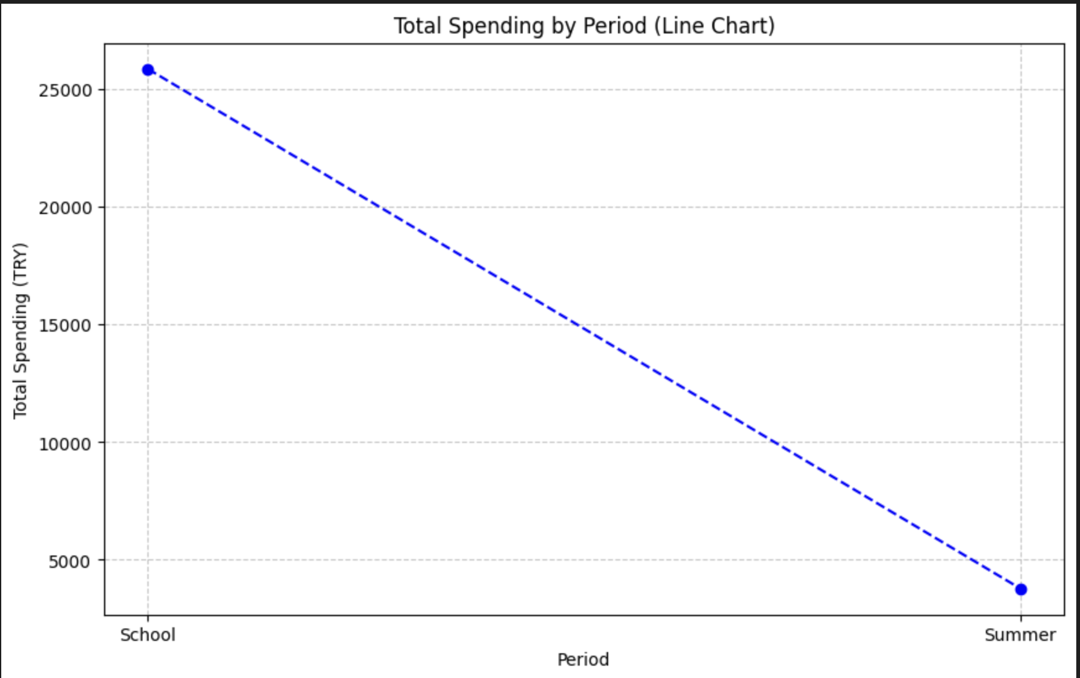
Summer break vs school perıod
This line chart shows total spending (in TRY) during the school period and summer. Spending during the school period is much higher, around 25,000 TRY, while summer spending drops significantly to below 5,000 TRY. This indicates that spending is more frequent or larger during the school period compared to the summer months. The sharp decline highlights a notable difference in spending habits between these two periods.

Slide 9
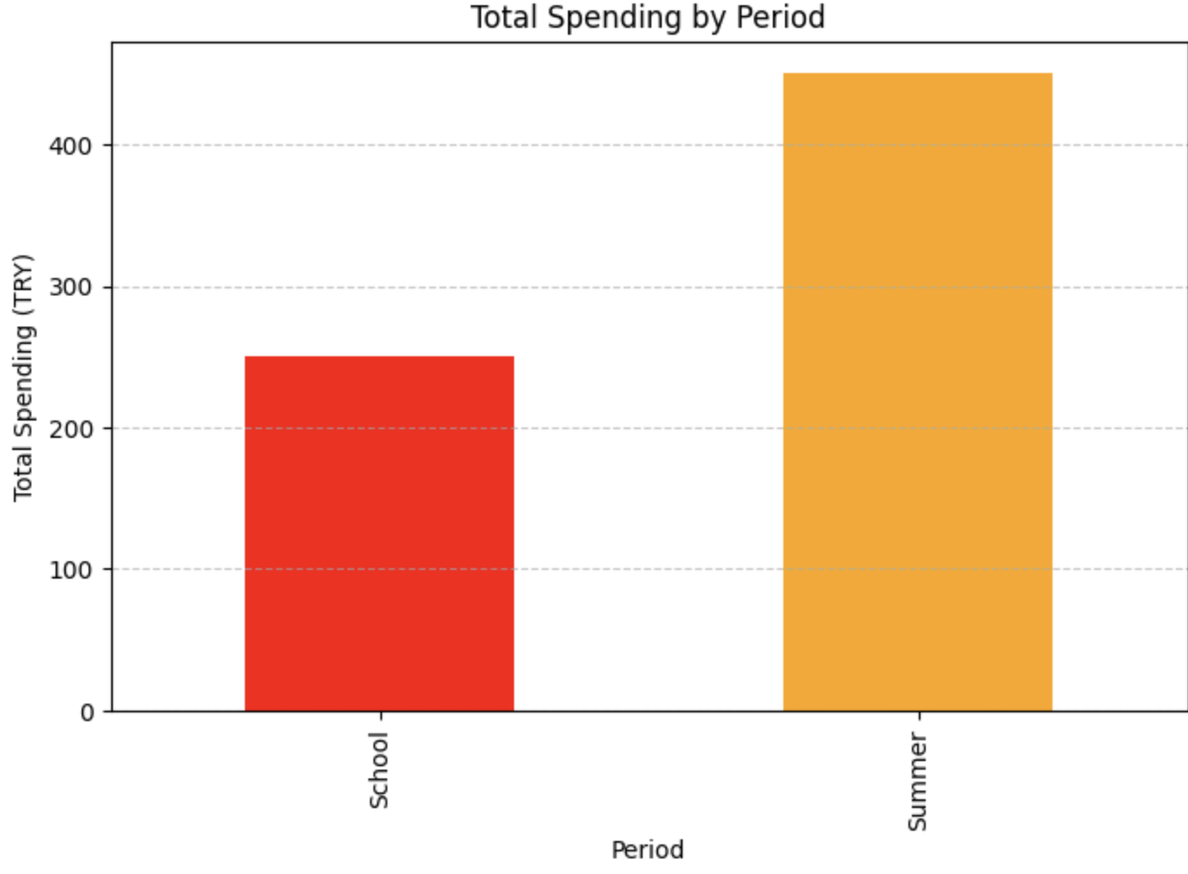
TOTAL SPENDING
This bar chart compares total spending (in TRY) during the school period and summer. Unlike the previous chart, spending in summer is significantly higher, exceeding 400, while spending during the school period is lower, around 200. This indicates that more money is spent during the summer, possibly due to increased activities, vacations, or leisure expenses.

Slide 10
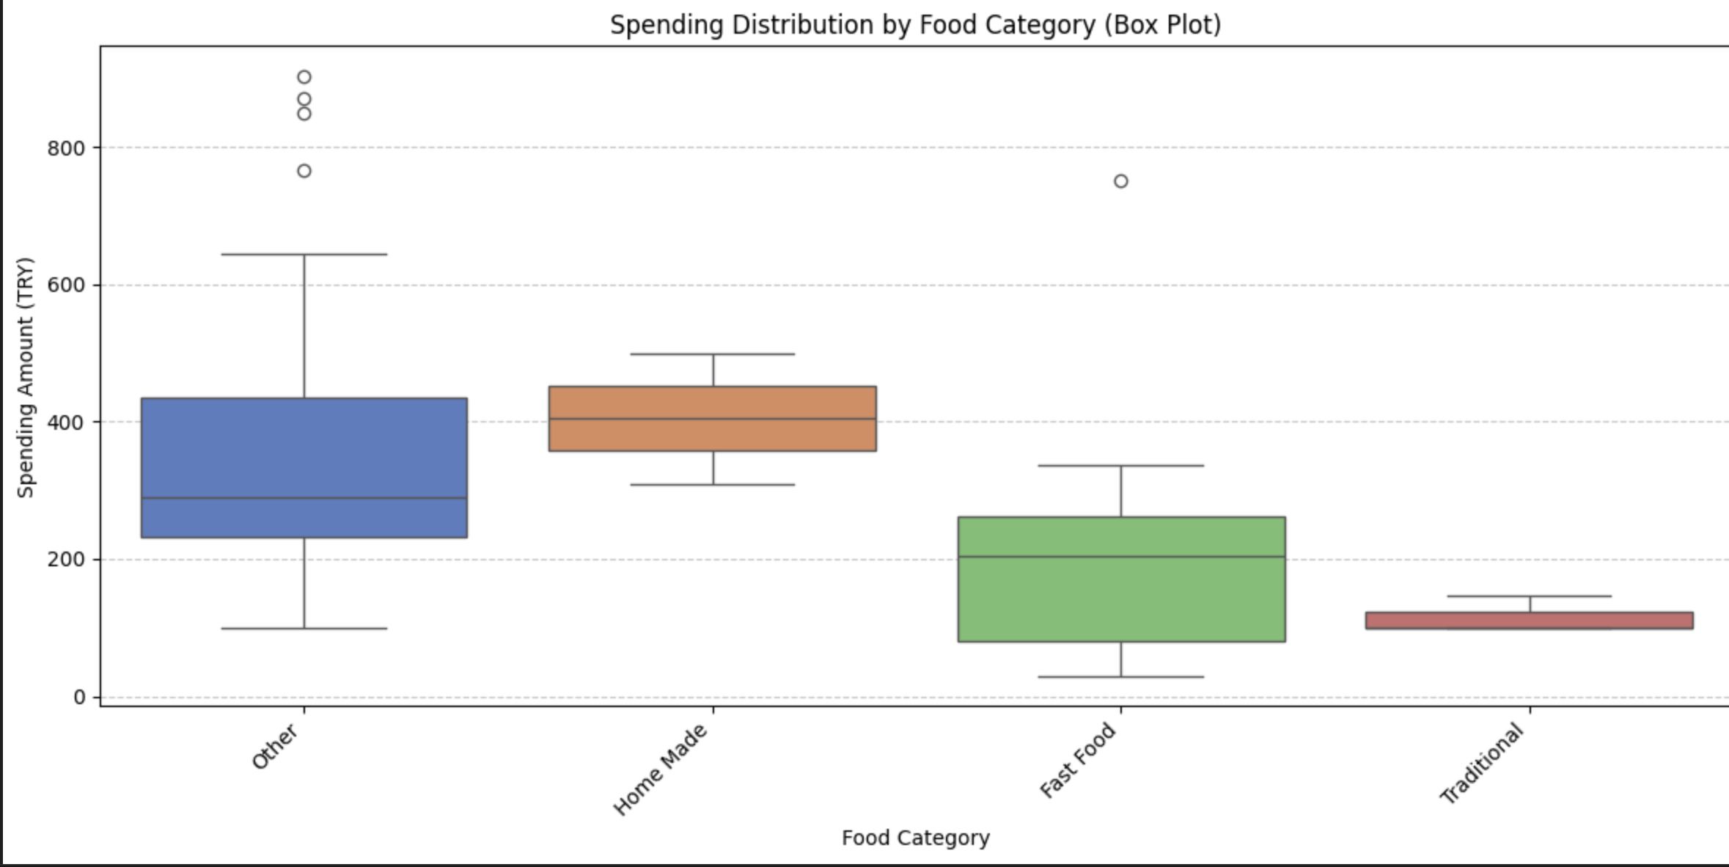
Food categorıes
Traditional food like kebap,lahmacun is the least expensive and has the most predictable spending pattern.
Other has the highest variability, indicating that it might include luxury or occasional items.
Spending on Home Made and Fast Food is moderate, with Home Made having slightly higher median spending than Fast Food.
This plot highlights differences in spending behavior across food categories, with clear distinctions between consistency and variability.

Slide 11
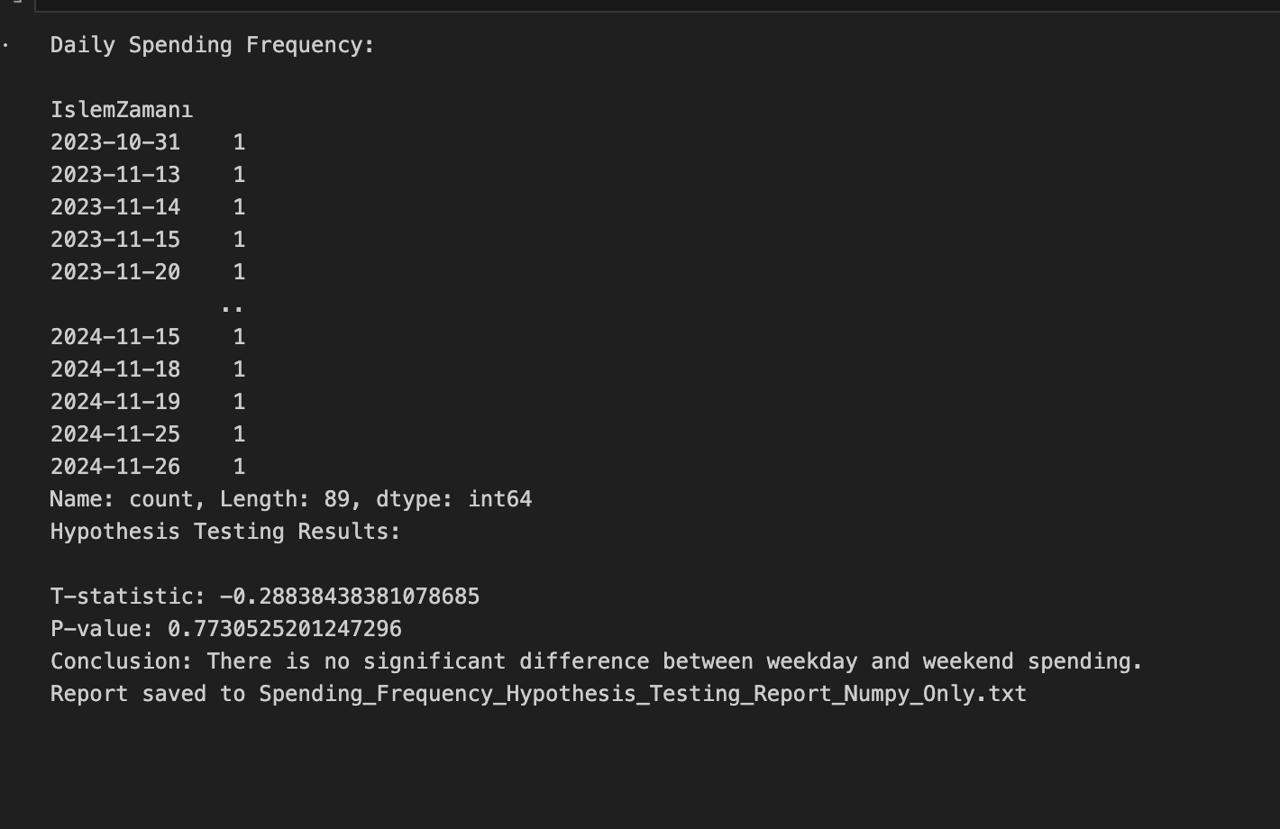
HYPOTHESIS TESTING AND P-VALUE
The output shows daily spending frequency and the results of a hypothesis test. The test compares weekday and weekend spending. The T-statistic is -0.288 and the P-value is 0.773. Since the P-value is greater than 0.05, the conclusion is that there is no significant difference between weekday and weekend spending. The results are saved in a report named Spending_Frequency_Hypothesis_Testing_Report_Numpy_Only.txt.

Slide 12
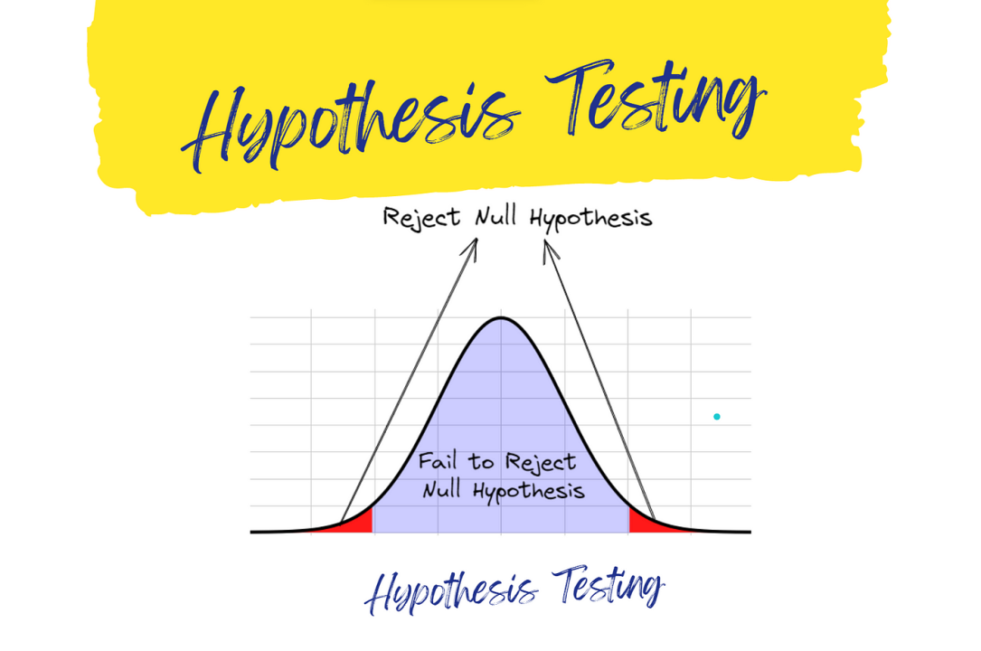
dEFINING HYPOTHESIS
Null Hypothesis (H₀): There is no significant difference in daily spending amounts between Weekdays and Weekends.Alternative Hypothesis (Hₐ): There is a significant difference in daily spending amounts between Weekdays and Weekends
Selecting the Test Statistic We selected the independent samples T-test because we are comparing the means of daily spending amounts between two independent groups (Weekdays and Weekends).
Determining the Significance Level The significance level (α) was set to 0.05, representing a 5% risk of rejecting the null hypothesis when it is true.
This aligns with your analysis and the hypothesis testing results shown in your project, where the P-value (0.773) was greater than 0.05, leading to the conclusion that there is no significant difference in spending between weekdays and weekends.

